Slide 1



Drugs administered by iontophoresis and phonophoresis

Slide 2
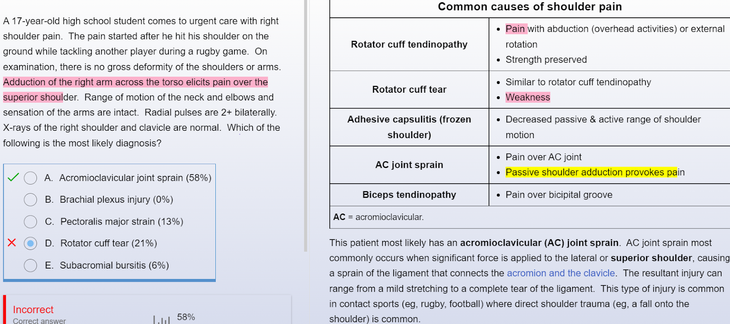

Slide 3
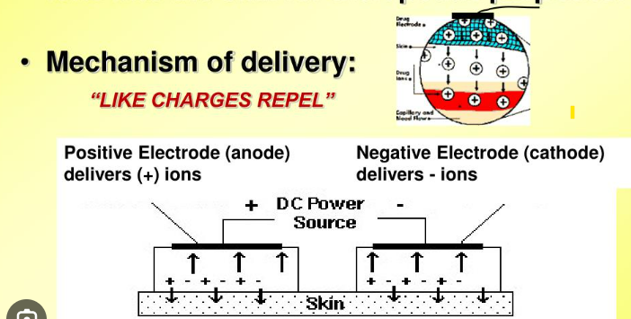
Iontophoresis, a form of transdermal drug delivery (TDD) that utilizes electrical current to drive or push ionized drugs through the skin’s outermost layer (stratum corneum) which is typically the main barrier to drug transport

Slide 4
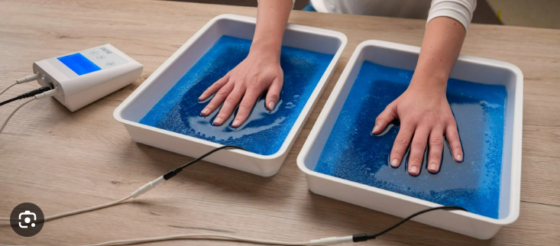
The drug is applied under an electrode of the same charge as the drug, and a return electrode opposite in charge to the drug is placed at a neutral site on the body surface.
The operator then selects a current below the level of the patient′s pain threshold and allows it to flow for an appropriate length of time. The electrical current significantly increases the penetration of the drug into surface tissues by repulsion of like charges and attraction of opposite charges.
The two classically considered prerequisites for iontophoretic treatment are that the drug must be charged (or modified to carry a charge) and that the disease process must be at or near a body surface.

Slide 5
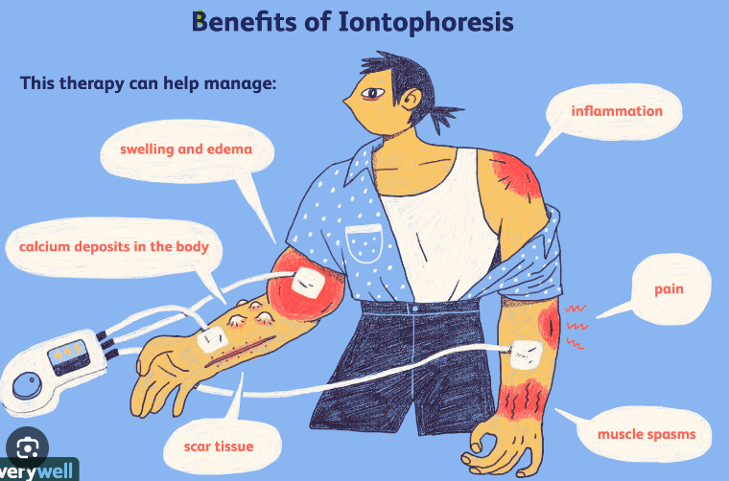

Slide 6
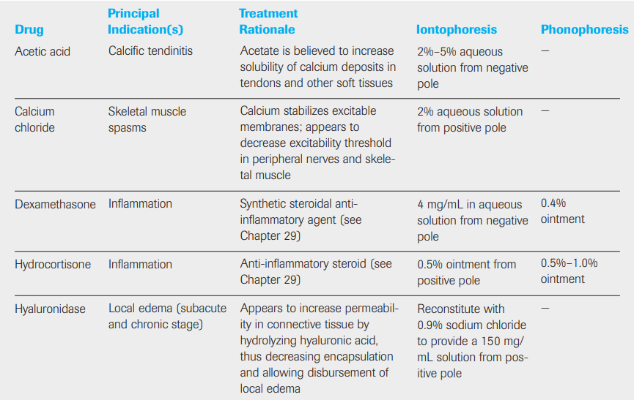

Slide 7
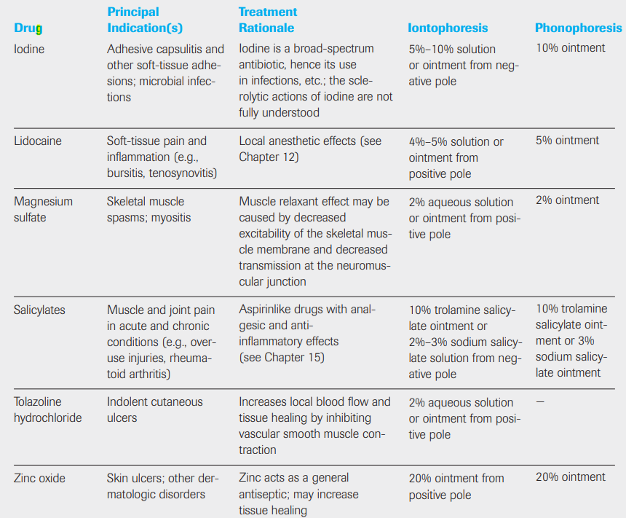

Slide 8
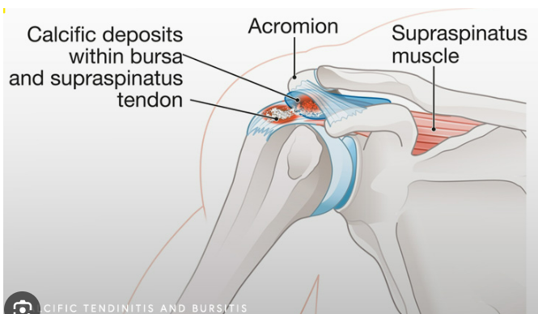
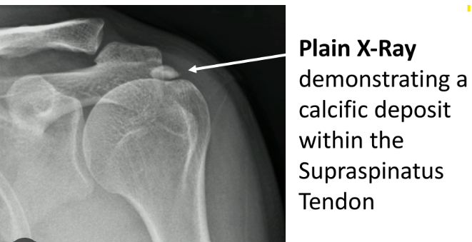
Calcific supraspinatus tendonitis (CST)
Deposition of calcium crystals within the substance matrix of the common rotator cuff tendon.
inside the supraspinatus tendon near the greater tuberosity of the humerus insertion point
Ultrasonography and MRI have been used to detect these calcium carbonate deposits.
Sudden shoulder pain or stiffness. Intense pain with shoulder movement. Severe pain that disrupts sleep. Reduced range of motion
Application of acetic acid to the affected tissue may have a beneficial effect on this condition via the conversion of calcium carbonate to calcium citrate, a much more soluble compound that is more readily absorbable by local blood circulation.

Slide 9


Slide 10


Slide 11
Lateral epicondylitis, medial epicondylitis, plantar fasciitis, tendonitis/bursitis, rheumatoid arthritis, and enthesopathic conditions of various origins.
The most popular and well researched iontophoresis application is the use of dexamethasone, a corticosteroid in a sodium phosphate solution.
In this form, the drug is composed of negatively charged ions of dexamethasone phosphate and, when loaded into a negatively charged reservoir or electrode pad, the electrical force of the like charges pushes the medication molecules into the desired area.
The results of a study, suggests that iontophoresis using a solution of dexamethasone with lidocaine hydrochloride
is effective in the treatment of recreational tennis players suffering from Lateral Epicondylitis
in terms of reducing pain and improving function.

Slide 12
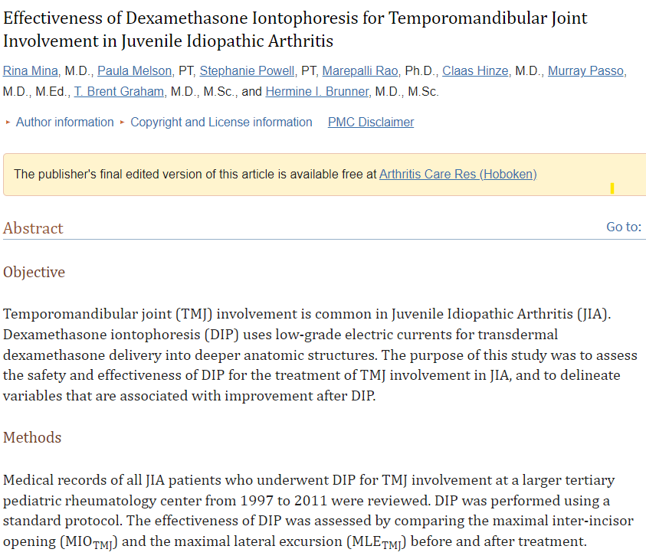
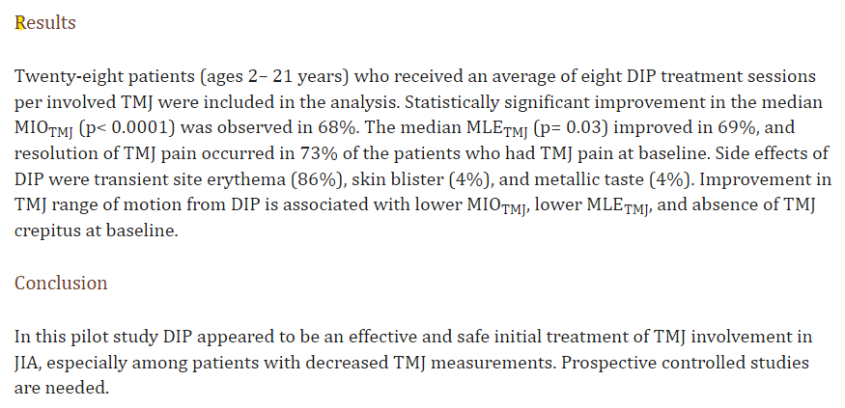

Slide 13
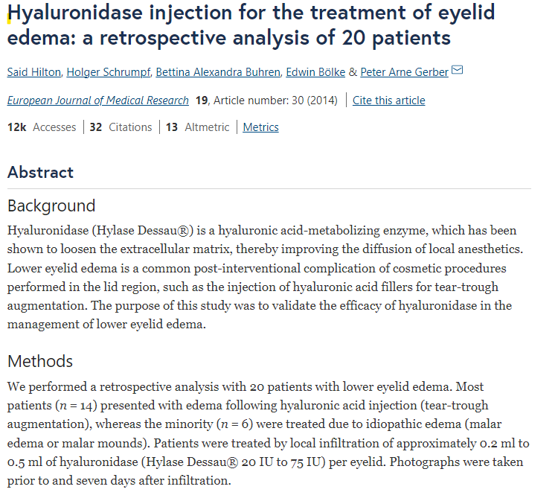
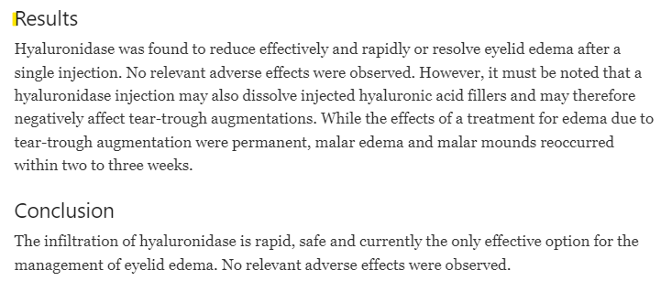
Hyaluronidase is a medication used to help treat soft tissue edema or swelling.
If you have swelling after injury or surgery, it may be effective in the acute or
chronic stages of healing to help manage edema.

Slide 14
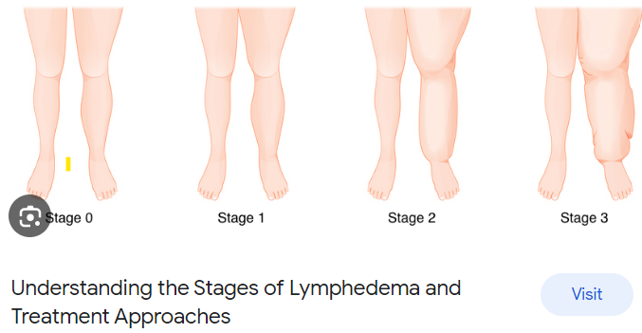
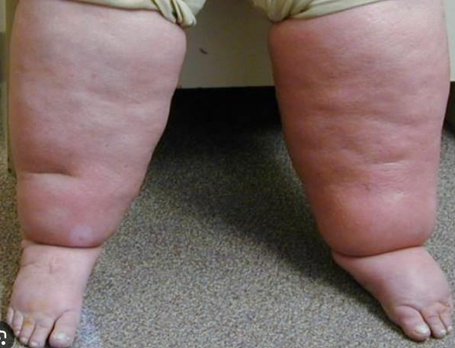

Slide 15
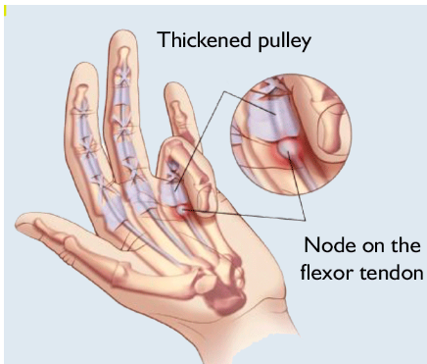
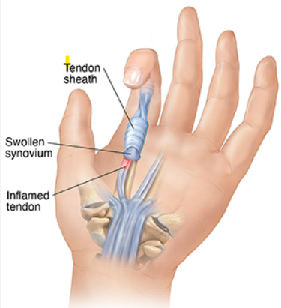
Iodine has been reported to be helpful as a medication to help treat sclerotic conditions such as frozen shoulder and fibrosis, adhesions, scar tissue, trigger finger . It has also been shown to help improve local blood flow to tissues when used in iontophoresis.
Trigger finger is a condition that affects one or more of the hand's tendons, making it difficult to bend the affected finger or thumb.

Slide 16
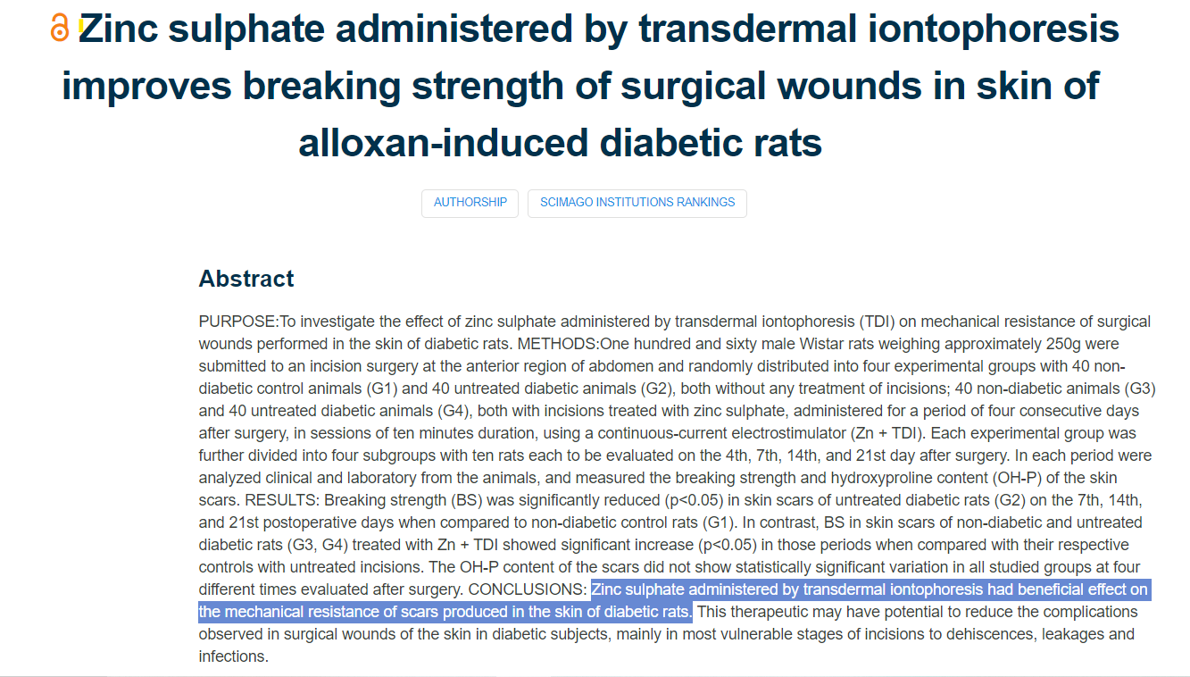

Slide 17
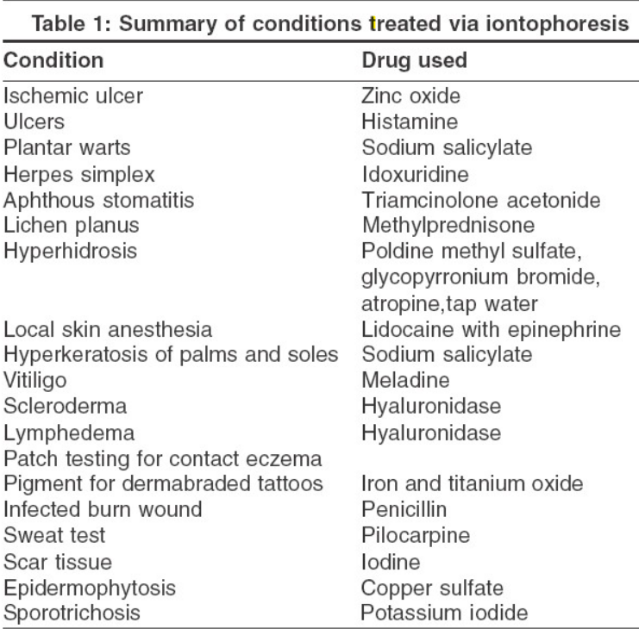

Slide 18


Slide 19
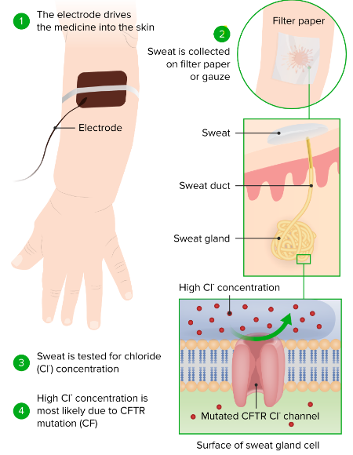
Sweat test: Iontophoresis was also used for the diagnosis of cystic fibrosis by the sweat test.
Iontophoresis with pilocarpine causes rapid sweating
for minutes

Slide 20
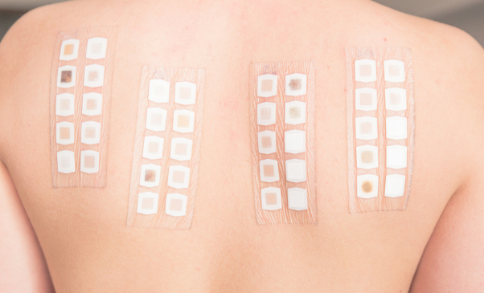
Patch testing: Wahlberg reported encouraging results with the use of iontophoresis as a complement to ordinary patch testing in the investigation of obscure cases of contact eczema.
With iontophoresis, the test substances are administered rapidly and they migrate through the epidermis down into the dermis.
Additionally, the disadvantages of the traditional patch test procedure, such as prolonged wearing of the test strips, are eliminated.

Slide 21

Hyperhidrosis The most successful application of iontophoresis is for the treatment of hyperhidrosis.
Currently, the most commonly used conducting medium is tap water because it is safe and effective.
The most widely accepted hypothesis is that sweating is inhibited by mechanical blockage of the sweat ducts at the stratum corneum level, the depth and severity of the damage being dose-related.

